Slide 1
Slide Deck of Visuals and Logos

Slide 2
Contents
How to Use, slide 3
TCPHC Logos, slides 4 - 6
Work Group Icons, slide 7
Visual Data Representations, slides 8 - 13
Healthy N.C. 2020 Objectives, slides 14 - 28

Slide 3
How to Use
Welcome to the Twin Counties Partnership for Healthier Communities Slide Deck of Visuals and Logos! In it, you will find visual representations of data and graphics created for the Partnership. The data source is given in the notes section of each slide.

Slide 4
Logos
Guidelines for Logo Use
This information is also provided as a separate Word document within the Toolkit.
The logo for the Twin Counties Partnership for Healthier Communities is available for member agencies to use. The Partnership requests that member agencies adhere to the following guidelines when using the Partnership logo:
1. The Partnership logo was created specifically for the Partnership and is the property of the Partnership.
2. The logo is designed to be used to promote work that the Partnership is doing. If the Partnership is collaborating with one or more agencies, it is appropriate for the Partnership logo to be displayed next to the logo(s) of the other agencies.
Note: if the Partnership is not directly involved with the work, do not use the Partnership logo in any materials promoting the work.
3. There are a variety of sizes and colors available for member agency use. Please make use of what is available and do not alter the shape, color, or fonts of any of the logos. This includes:
Changing the color palette
Switching the order of the colors on the logo
Rearranging elements of the logo
Distorting the logo through stretching or alteration of the proportions
4. As a courtesy, please allow the Partnership 3C Work Group to review any promotional material that contains the logo and a description of the Partnership. You may send documents for review to Becky Copeland, Partnership Coordinator, at rlcopeland@nhcs.org.
If you have any questions regarding communication and logo usage, please reach out to Becky Copeland at rlcopeland@nhcs.org.

Slide 5
Logo Descriptions In addition to the logos on the next slide, the original files of the logos are available through the Partnership. Contact the Partnership Coordinator, Becky Copeland at rlcopeland@nhcs.org, for these files.
Partnership Logo with Text
tcphc-rgb.jpg: 3600 x 3600 pixels, 1.4MB
This figure has a high resolution in a small, compressed file size (JPEG), and is ideal for insertion into web content, reports and other documents
tcphc-rgb.png: 3600 x 3600 pixels, 50.7MB
This figure has a high resolution in a larger file size with a transparent background, and is ideal for graphic design tasks where very high resolution images are necessary
tcphc-cmyk.jpg: 3600 x 3600 pixels, 55.7MB
This figure has high resolution and is ideal for graphic design tasks where the products will be printed
Partnership Logo without Text
tcphc-rgb-noType.jpg: 3600 x 3600 pixels, 934KB
This figure has a high resolution in a small, compressed file size (JPEG), and is ideal for insertion into web content, reports and other documents
tcphc-rgb-noType.png: 3600 x 3600 pixels, 467KB
This figure has a high resolution in a larger file size with a transparent background, and is ideal for graphic design tasks where very high resolution images are necessary
tcph-cmyk-noType.jpg: 3600 x 3600 pixels, 1.5MB
This figure has a high resolution and is ideal design tasks where the product will be printed

Slide 6
CMYK JPG
RGB JPG
RGB PNG
CMYK JPG
RGB JPG
RGB PNG
Notes:
This slide contains both PNG and JPG files.

Slide 7
Work Group Icons
Active Living
Work Group
Physical & Behavioral
Health Work Group
3C
Work Group

Slide 8
Visual Data Representation
The visuals provided in this section were created for inclusion on communication materials from the Partnership.

Slide 9
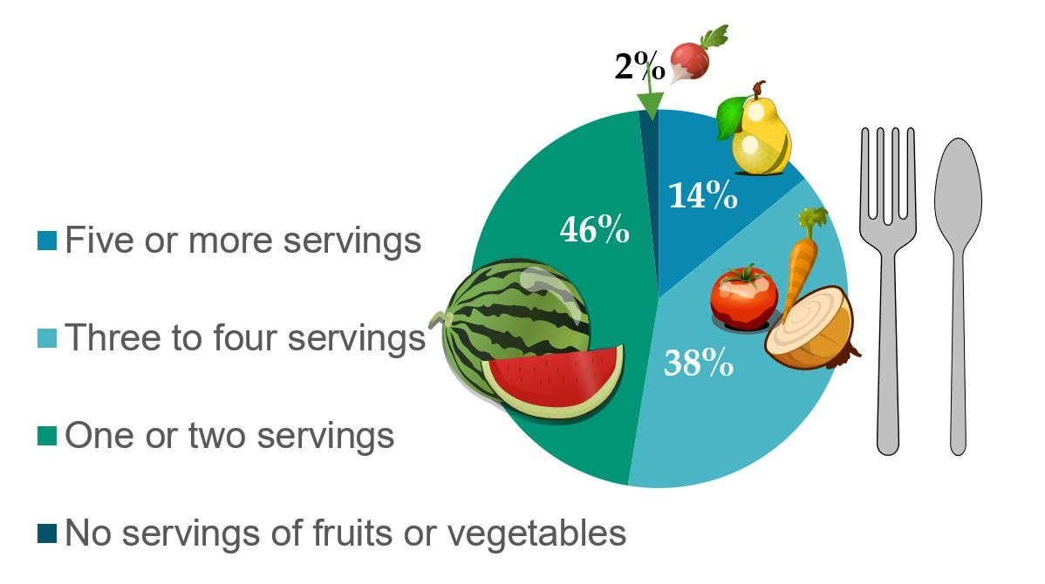
What percentage of adult residents in the Twin Counties are eating the recommended five or more servings of fruits and vegetables a day?
Notes:
Source: North Carolina Institute of Public Health, Twin Counties Community Health Opinion Survey Data Workbook, 2017.

Slide 10
Are residents of the Twin Counties meeting the Healthy Carolina 2020 objectives of 150 minutes/week of moderate or 75 minutes/week of vigorous physical activity?
Notes:
Source: North Carolina Institute of Public Health, Twin Counties Community Health Opinion Survey Data Workbook, 2017.

Slide 11
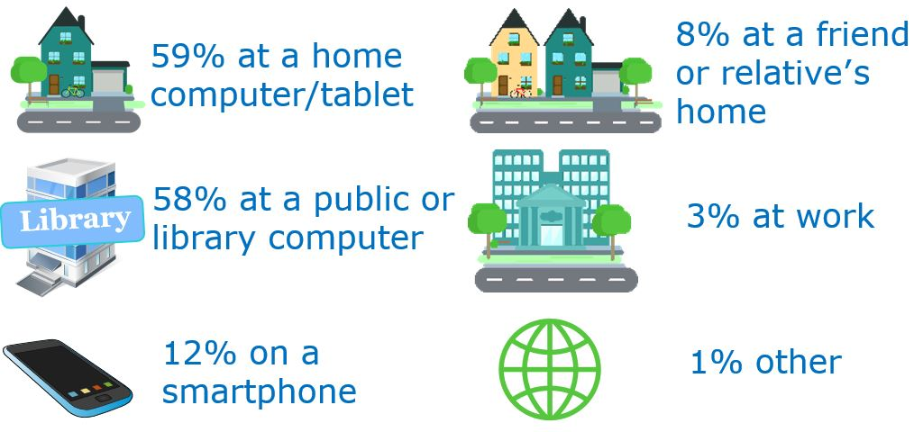
What ways do you access the internet? Respondents chose all that applied. Totals > 100%
Notes:
Source: North Carolina Institute of Public Health, Twin Counties Community Health Opinion Survey Data Workbook, 2017.

Slide 12
How are you likely to find out about health care, 5k, or healthy fun days?*
*Respondents chose all that applied. Totals > 100%
Notes:
Source: North Carolina Institute of Public Health, Twin Counties Community Health Opinion Survey Data Workbook, 2017.

Slide 13
For how many days during the past 30 days was your mental health not good?
Notes:
Source: North Carolina Institute of Public Health, Twin Counties Community Health Opinion Survey Data Workbook, 2017.

Slide 14
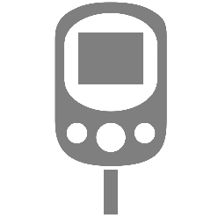
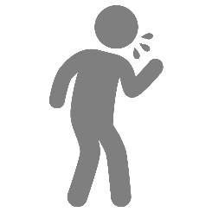
Healthy N.C. 2020 Objectives Comparing Nash and Edgecombe Counties with Healthy North Carolina 2020 Targets
HIV

Slide 15
Objective | Target | Nash † | Edgecombe †
Reduce the homicide rate (per 100,000 population) | 7 | 3 | 27
Reduce the percentage of non-elderly uninsured individuals (aged less than 65 years) | 8% | 12% | 14%
Decrease the percentage of individuals living in poverty | 13% | 19% | 26%
Reduce the percentage of traffic crashes that are alcohol related | 5% | 6% | 7%
Reduce the suicide rate (per 100,000 population) | 8 | 10 | 8
Increase the four-year high school graduation rate | 95% | 81% | 79%
Increase the percentage of adults who consume 5+ fruits & vegetables per day‡ | 29% | 16% | 10%
Objective | Target | Nash † | Edgecombe †
Decrease the percentage of adults who are current smokers | 13% | 19% | 22%
Decrease the percent of people spending more than 30% of their income on housing | 36% | 36% | 39%
Decrease the percentage of adults with diabetes | 9% | 16.1%* | 23.2%*
Reduce the rate of new HIV infection diagnoses (per 100,000 population) | 22 | 16 | 30
Increase the percentage of adults meeting CDC aerobic recommendations | 61% | 48%* | 52%*
Reduce the pneumonia and influenza mortality rate (per 100,000 population) | 14 | 25 | 19
MET
NOT
MET
NOT
MET
NOT
MET
NOT
MET
NOT
MET
MET
NOT
MET
NOT
MET
NOT
MET
NOT
MET
NOT
MET
MET
NOT
MET
NOT
MET
NOT
MET
HIV
NOT
MET
MET
NOT
MET
NOT
MET
NOT
MET
NOT
MET
NOT
MET
NOT
MET
NOT
MET
NOT
MET
*Data represent weighted percent of survey respondents from the 2017 Twin Counties Community Health Survey.
†Unless otherwise noted, data comes from secondary sources including U.S. Census Bureau, CDC's Behavioral Risk Factor Surveillance System (BRFSS), N.C .Department of Health & Human Services and N.C. Department of Public Instruction, among others.
‡ 5 or more fruits & vegetables per day was the initial Healthy NC 2020 Objective published in 2011.
Top five quality of life community issues identified by survey respondents (1) crime/safety, (2) access to health care, (3) opportunities for youth, (4) elder care options, (5) income/employment.

Slide 16
Reduce the homicide rate
(per 100,000 population)
27
per 100,000 population
Healthy N.C. 2020 Target: 7 or lower
3
Notes:
Source: Data comes from secondary sources including the U.S. Census Bureau, CDC’s Behavioral Risk Factor Surveillance System (BRFSS), N.C. Department of Health & Human Services, & N.C. Department of Public Instruction, among others. For questions on secondary sources, contact nciph@unc.edu.

Slide 17
Reduce the percentage of
non-elderly uninsured
(aged less than 65 years)
Healthy N.C. 2020 Target: 8% or below
Notes:
Source: Data comes from secondary sources including the U.S. Census Bureau, CDC’s Behavioral Risk Factor Surveillance System (BRFSS), N.C. Department of Health & Human Services, & N.C. Department of Public Instruction, among others. For questions on secondary sources, contact nciph@unc.edu.

Slide 18
Decrease the percentage of
Individuals living in poverty
Healthy N.C. 2020 Target: 13% or below
Notes:
Source: Data comes from secondary sources including the U.S. Census Bureau, CDC’s Behavioral Risk Factor Surveillance System (BRFSS), N.C. Department of Health & Human Services, & N.C. Department of Public Instruction, among others. For questions on secondary sources, contact nciph@unc.edu.

Slide 19
Reduce the percentage of
traffic crashes that are
alcohol-related
6%
7%
Healthy N.C. 2020 Target: 5% or below
Notes:
Source: Data comes from secondary sources including the U.S. Census Bureau, CDC’s Behavioral Risk Factor Surveillance System (BRFSS), N.C. Department of Health & Human Services, & N.C. Department of Public Instruction, among others. For questions on secondary sources, contact nciph@unc.edu.

Slide 20
Reduce the suicide rate
(per 100,000 population)
per 100,000 population
Healthy N.C. 2020 Target: 8 or lower
Notes:
Source: Data comes from secondary sources including the U.S. Census Bureau, CDC’s Behavioral Risk Factor Surveillance System (BRFSS), NC Department of Health & Human Services, & NC Department of Public Instruction, among others. For questions on secondary sources, contact nciph@unc.edu.

Slide 21
Increase the four-year high
school graduation rate
Healthy N.C. 2020 Target: 95% or above
Notes:
Source: Data comes from secondary sources including the U.S. Census Bureau, CDC’s Behavioral Risk Factor Surveillance System (BRFSS), NC Department of Health & Human Services, & NC Department of Public Instruction, among others. For questions on secondary sources, contact nciph@unc.edu.

Slide 22
Increase the percentage of
adults who consume 5+
fruits & vegetables per day‡
Healthy N.C. 2020 Target: 29% or above
‡ 5 or more fruits & vegetables per day was the initial Healthy NC 2020 Objective published in 2011.
Notes:
Source: Data comes from secondary sources including the U.S. Census Bureau, CDC’s Behavioral Risk Factor Surveillance System (BRFSS), NC Department of Health & Human Services, & NC Department of Public Instruction, among others. For questions on secondary sources, contact nciph@unc.edu.

Slide 23
Decrease the percentage of
adults who are current
smokers
Healthy N.C. 2020 Target: 13% or below
Notes:
Source: Data comes from secondary sources including the U.S. Census Bureau, CDC’s Behavioral Risk Factor Surveillance System (BRFSS), NC Department of Health & Human Services, & NC Department of Public Instruction, among others.

Slide 24
Decrease the percent of people
spending more than 30% of
their income on housing
Healthy N.C. 2020 Target: 36% or below
Notes:
Source: Data comes from secondary sources including the U.S. Census Bureau, CDC’s Behavioral Risk Factor Surveillance System (BRFSS), NC Department of Health & Human Services, & NC Department of Public Instruction, among others. For questions on secondary sources, contact nciph@unc.edu.

Slide 25
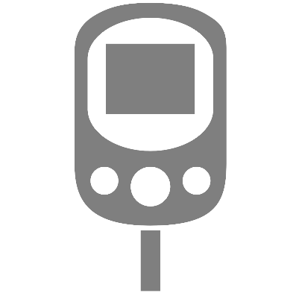
Decrease the percentage of
adults with diabetes
Healthy N.C. 2020 Target: 9% or below
*Data represent weighted percent of survey respondents from the 2017 Twin Counties Community Health Survey.
Notes:
Source: North Carolina Institute of Public Health, Twin Counties Community Health Opinion Survey Data Workbook, 2017.

Slide 26
Reduce the rate of new HIV
infection diagnoses
(per 100,000 population)
HIV
Healthy N.C. 2020 Target: 22 or lower
per 100,000 population
Notes:
Source: Data comes from secondary sources including the U.S. Census Bureau, CDC’s Behavioral Risk Factor Surveillance System (BRFSS), NC Department of Health & Human Services, & NC Department of Public Instruction, among others. For questions on secondary sources, contact nciph@unc.edu.

Slide 27
Increase the percentage of
adults meeting CDC aerobic
recommendations
Healthy N.C. 2020 Target: 61% or above
*Data represent weighted percent of survey respondents from the 2017 Twin Counties Community Health Survey.
Notes:
Source: North Carolina Institute of Public Health, Twin Counties Community Health Opinion Survey Data Workbook, 2017.

Slide 28
Reduce the pneumonia and
influenza mortality rate
(per 100,000 population)
per 100,000 population
Healthy N.C. 2020 Target: 14 or lower
Notes:
Source: Data comes from secondary sources including the U.S. Census Bureau, CDC’s Behavioral Risk Factor Surveillance System (BRFSS), NC Department of Health & Human Services, & NC Department of Public Instruction, among others. For questions on secondary sources, contact nciph@unc.edu.

